Slide 1
SO, YOU THOUGHT BANKS CREATE ALL THE MONEY

Slide 2
SO, YOU THOUGHT THE STATE CREATES ALL THE MONEY

Slide 3


Slide 4


Slide 5
REVENUE IN ITS MONETARY FORM IS SOCIAL VALUE IN ITS CIRCULATING FORM

Slide 6
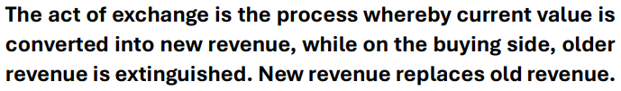

Slide 7
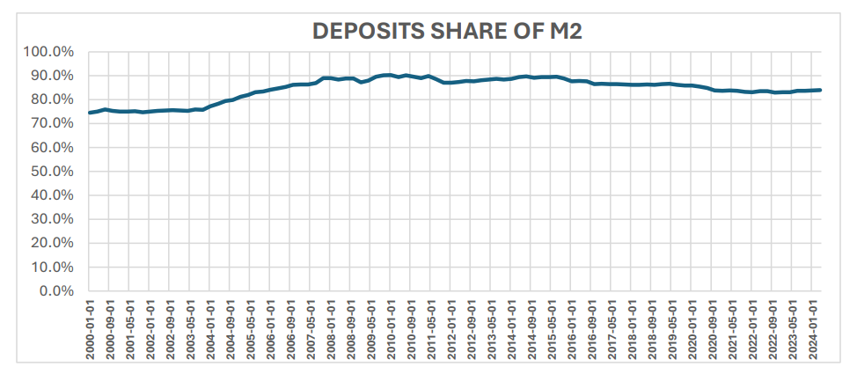

Slide 9
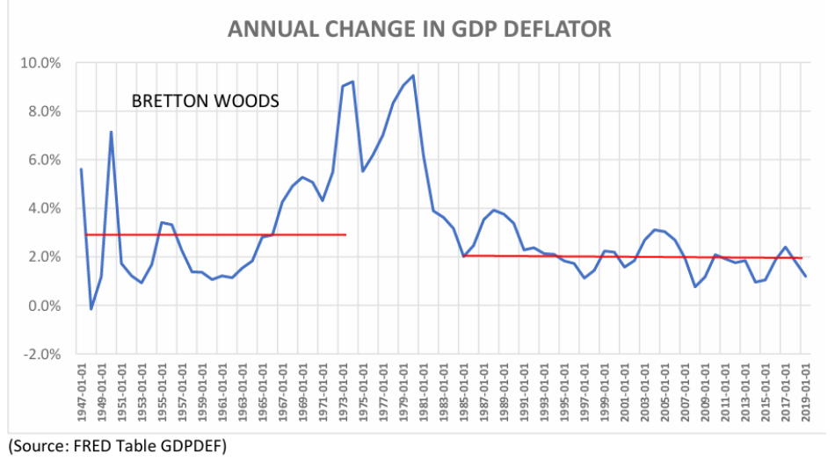

Slide 10
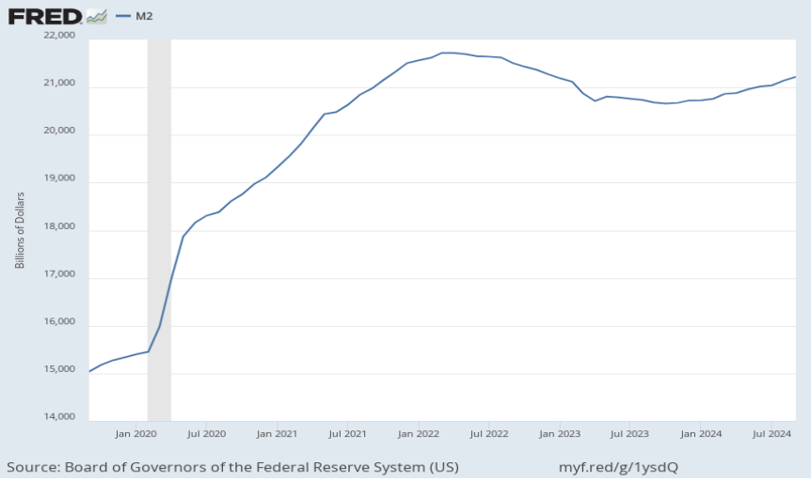

Slide 11


